Slide 1

Note: The data and information in this document is reflective of a hypothetical situation and client. This document is to be used for KPMG Virtual Internship purposes only.
Sprocket Central Pty Ltd
Data analytics approach
[Division Name] - [Engagement Manager], [Senior Consultant], [Junior Consultant]

Slide 2
Note: The data and information in this document is reflective of a hypothetical situation and client. This document is to be used for KPMG Virtual Internship purposes only.
Introduction
Outline of Problem:
Contents of Data Analysis:
Sprocket Central Pty Ltd is a Medium size bikes and cycling accessories organization
Needs help with its customer and transaction data
Goal: optimize the quality of customer dataset and drive company growth by effectively allocating company resources and focusing on high value customer
1. Age distribution between new and old customers
2. Bike related purchases over the last past 3 years by gender
3. Wealth Segments by age category
4. Job Industry distributions
5. Number of cars owned in each State
6. RFM customer analysis
This will be done with 3 processes: Data Exploration, Model Development, and Interpretation

Slide 3
Note: The data and information in this document is reflective of a hypothetical situation and client. This document is to be used for KPMG Virtual Internship purposes only.
Data Exploration
Data Exploration
Data is cleaned by using both excel and python
Missing values are removed
Inconsistent values are corrected
Type of values are corrected
Profit, Age, Recency columns are added in Transactions Worksheet for better customer analysis
Age and Age Category columns are added in New Customer List and Customer Demographic Worksheets

Slide 4
Note: The data and information in this document is reflective of a hypothetical situation and client. This document is to be used for KPMG Virtual Internship purposes only.
Interpretation
Age distribution
Most of our existing customers are between 40-60 years old
The lowest age groups are under 20 and 80+ for both new and existing customers
New customers are mostly 30s, 50-70s.
Number of new customers in theirs 70s has slightly increased
Number of new customers in theirs 40s has dropped signifantly
Number of young customers in theirs 20s hasn’t changed a lot

Slide 5
Note: The data and information in this document is reflective of a hypothetical situation and client. This document is to be used for KPMG Virtual Internship purposes only.
Interpretation
Number of bike purchases in past 3 years
We have more female customers with 50.3% purchase with total of 98,359 bikes
Male customers contributed to 47.8% purchase with total of 93483 bikes
Differences are not huge so our marketing focus can stay the same but can consider coming out with more female oriented accessories

Slide 6
Note: The data and information in this document is reflective of a hypothetical situation and client. This document is to be used for KPMG Virtual Internship purposes only.
Interpretation
Wealth Segments
The largest number of customers are classified as “Mass Customer” and they are in their 50s
The next category is “High Net Worth” customers
We have equal number of “High Net Worth” and “Affluent Customer” new customers in their 50s
We can come out with high ticket products to better suited with affluent customers’ needs

Slide 7
Note: The data and information in this document is reflective of a hypothetical situation and client. This document is to be used for KPMG Virtual Internship purposes only.
Interpretation
Job Industry
Most of our existing and new customers are in Financial and Manufacturing industry

Slide 8
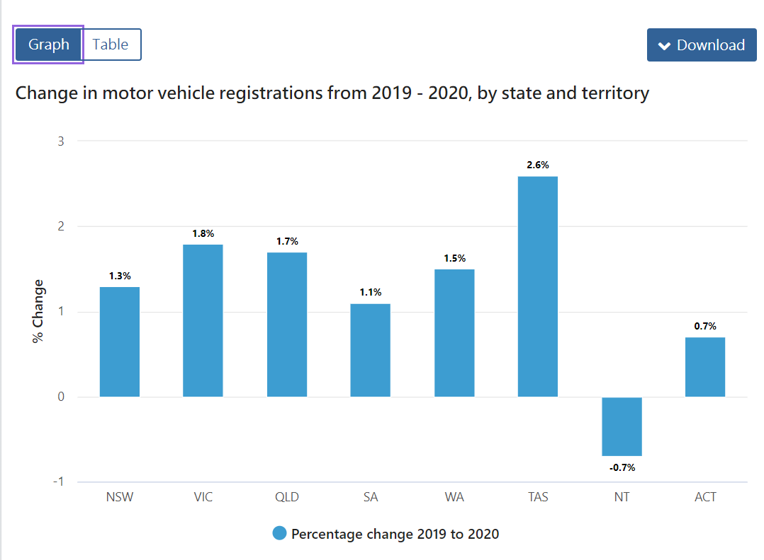
Note: The data and information in this document is reflective of a hypothetical situation and client. This document is to be used for KPMG Virtual Internship purposes only.
Interpretation
Number of cars owned in each State
Looking from Australian Census, there is biggest increase of car registration in VIC and less increase in NSW
NSW has the largest amount of people that do not own a car
NSW has the highest number of people from which data was collected
It is advised to target customers in NSW who already owned a car(most likely to be affluent or high net worth customer)

Slide 9
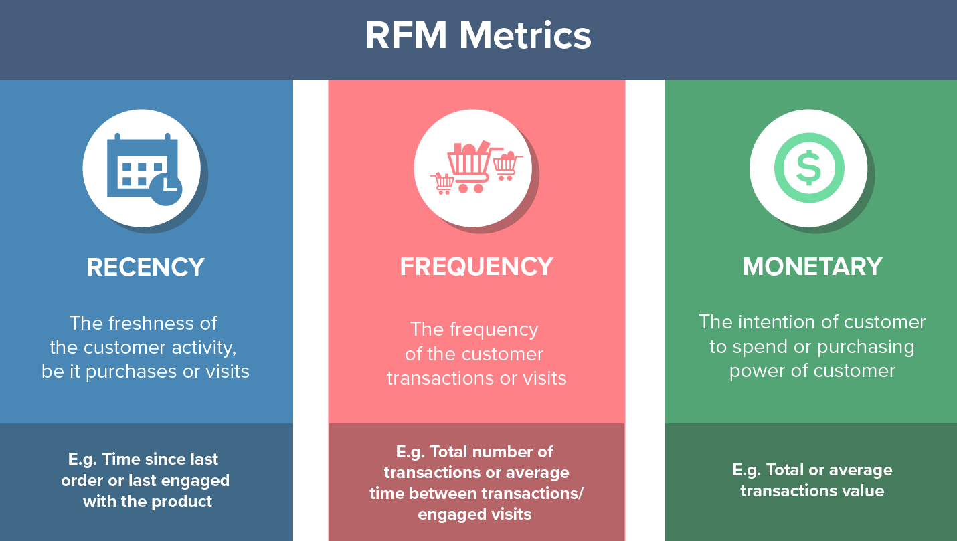
Note: The data and information in this document is reflective of a hypothetical situation and client. This document is to be used for KPMG Virtual Internship purposes only.
Model Development
Customers RFM Analysis
RFM analysis is used to identify which customers has more business values in terms of revenue
It is calculated using Recency, Frequency, and Monetary which represents customers’ most recent purchase, loyalty and profits derived from customers

Slide 10
Note: The data and information in this document is reflective of a hypothetical situation and client. This document is to be used for KPMG Virtual Internship purposes only.
Model Development
RFM Analysis Process
Understand of data (frequency, recency of purchase, profits)
Assigning Recency Score(arrange data in descending order basis with last purchase date→ assign 3 scores to top 33% customer, assign 2 score to the next 33% customer and assign 1 score to bottom 33%)
Assign Frequency score(arrange data in descending order basis with number of purchase, assign score like in step2)
Assigning Monetary score (arrange data in descending order basis total sales value, assign score like in step2)
RFM score calculation: Recency(R) * 100 + Frequency(F) *10 + Monetary(M)*1
Classify the customer to (Platinum, Gold, Silver and Bronze)
Application(to improve customer lifetime value(reduce churn, cross sells, sell high ticket items), minimize marketing costs and improve role→use small segment of customer and make decision based on data

Slide 11
Note: The data and information in this document is reflective of a hypothetical situation and client. This document is to be used for KPMG Virtual Internship purposes only.
Model Development
Customers RFM Analysis
Understand of data (frequency, recency of purchase, profits)
Assigning Recency Score(arrange data in descending order basis with last purchase date→ assign 3 scores to top 33% customer, assign 2 score to the next 33% customer and assign 1 score to bottom 33%)
Assign Frequency score(arrange data in descending order basis with number of purchase, assign score like in step2)
Assigning Monetary score (arrange data in descending order basis total sales value, assign score like in step2)
RFM score calculation: Recency(R) * 100 + Frequency(F) *10 + Monetary(M)*1
Classify the customer to (Platinum, Gold, Silver and Bronze)
Application(to improve customer lifetime value(reduce churn, cross sells, sell high ticket items), minimize marketing costs and improve role→use small segment of customer and make decision based on data

Slide 12
Note: The data and information in this document is reflective of a hypothetical situation and client. This document is to be used for KPMG Virtual Internship purposes only.
Appendix

Slide 13
Note: The data and information in this document is reflective of a hypothetical situation and client. This document is to be used for KPMG Virtual Internship purposes only.
Appendix
This is an optional slide where you may place any supporting items.

